Slide 1

Predicting Emergency Response Times in NYC
Arunesh Kumar Rai
Anupam Semwal
Manasa Siddharamaiah

Slide 2

INTRODUCTION
Emergency response time is not just a number; it's a life-saving metric. In New York City, where every second counts, understanding and improving these times can make the difference between life and death. This project dives into NYC's dispatch dataset to uncover patterns and build predictive models.
Our goal is to build predictive models that can help understand how response times vary across different scenarios. By analysing these patterns, we aim to provide valuable insights to improve emergency resource allocation and planning. The final results will be presented in a clear and accessible way, highlighting important trends that can assist emergency services in making data-driven decisions and optimizing their operations.

Slide 3

Data Sources
The data for this project was sourced from the NYC Open Data platform, which provides comprehensive historical records of emergency dispatch incidents in New York City.
The dataset has about 20 million rows, but due to processing limitations, we selected a smaller sample of 3 million rows. This sample covers data from January 1, 2022, to December 31, 2023.
We will clean and analyze this data to focus on trends and patterns, making it ready for building predictive models and answering key research questions.

Slide 4
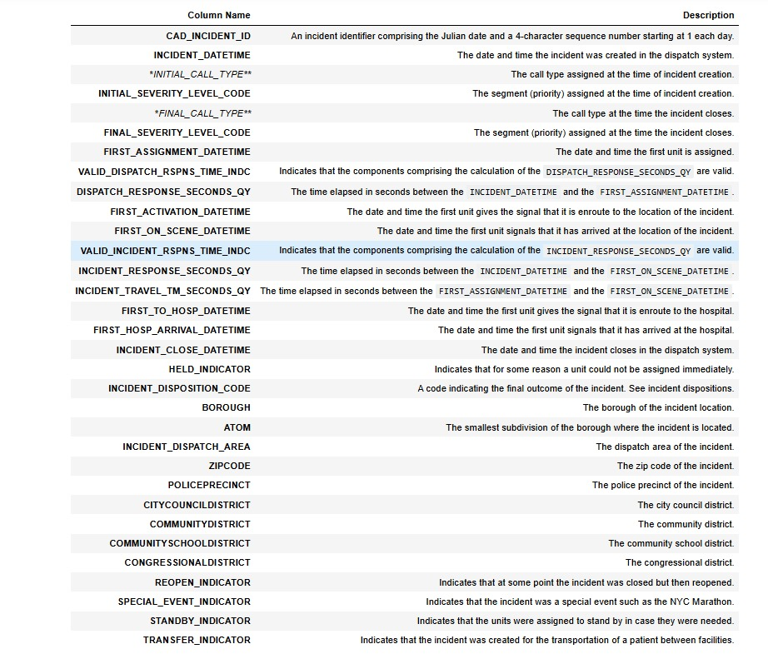
Data DICTIONARY
The dataset provides detailed information on emergency dispatch incidents in New York City, with various attributes for each record

Slide 5

Research Question
How accurately can emergency response times in NYC be predicted using different variable?
What are the most influential factors—incident type, location, time of day and more in determining emergency response times in NYC, and how can these insights be used to optimize resource allocation?
Are there specific locations in NYC where EMS response times are consistently longer?

Slide 6
DATA PRE-PROCESSING
Objective : To prepare the dataset for analysis and modeling by extracting meaningful features and removing irrelevant or redundant variables.
Datetime Feature Engineering:
- Converted INCIDENT_DATETIME to a datetime object for feature extraction.
- Created the following new features:
- Year (incident_year).
- Month (incident_month).
- Weekday (incident_weekday).
- Total Minutes (total_minutes) calculated as hour * 60 + minute.
- Dropped the original INCIDENT_DATETIME column after extraction.
Removed variables that are irrelevant for analysis.

Slide 7
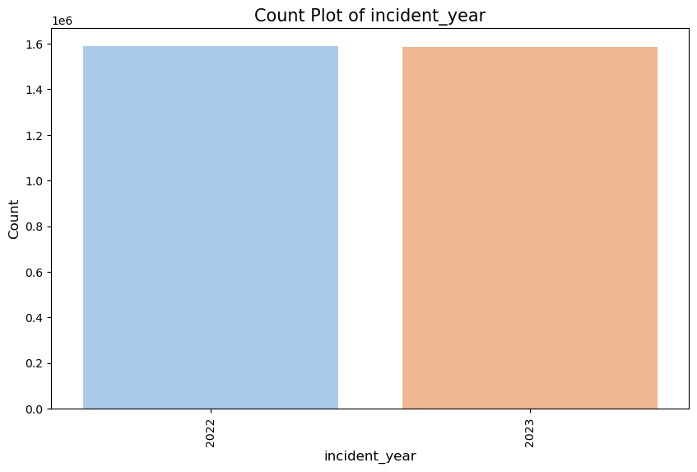
Exploratory data analysis
The incident year count plot shows an even distribution, with approximately 1.59 million incidents in both 2022 and 2023

Slide 8
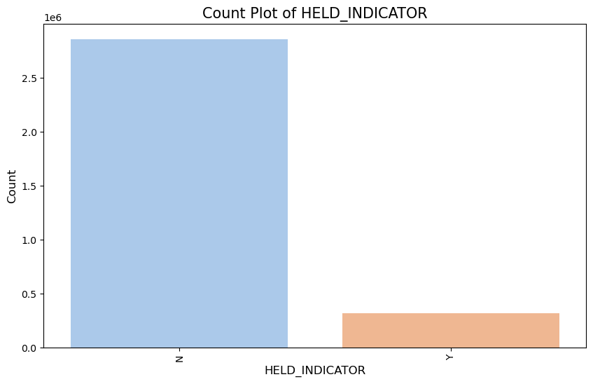
This plot shows most incidents (2.85 million) faced no delays, while about 320,000 were delayed, This suggests that unit availability is generally sufficient but that certain conditions may lead to delays.

Slide 9
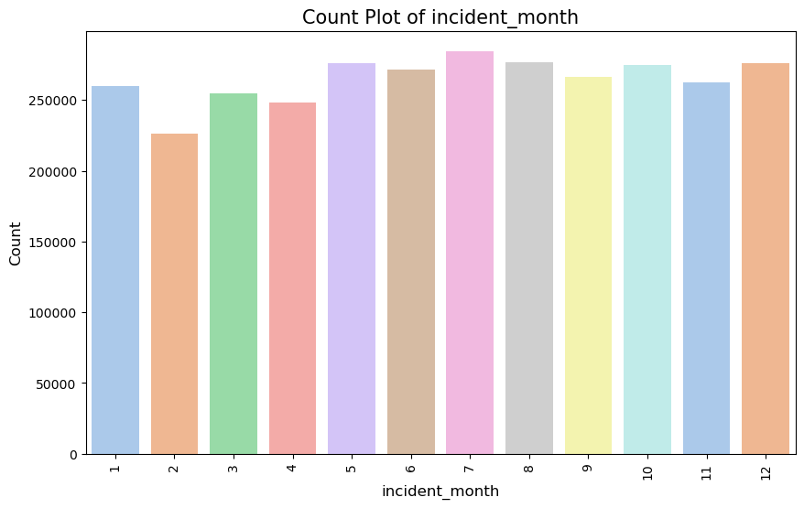
The plot shows that emergency incidents are consistent throughout the year, with counts exceeding 200,000 per month.

Slide 10
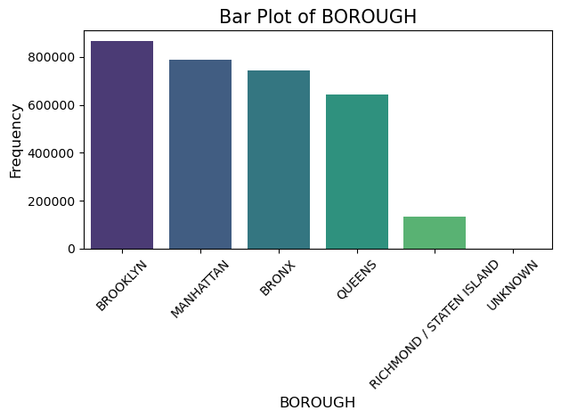
The BOROUGH bar plot shows most incidents in Brooklyn, Manhattan, and the Bronx, with fewer in Queens and Staten Island, highlighting potential response challenges in densely populated areas.

Slide 11
Data preparation
Categorization:
Grouped INITIAL_CALL_TYPE into 26 meaningful categories (e.g., Injury/Trauma, Sick Patient, etc.).
Created INITIAL_CALL_TYPE_GROUPED and dropped the original column.
Encoding:
Applied one-hot encoding to variables like BOROUGH, incident_month, and INITIAL_CALL_TYPE_GROUPED.
Response Level Creation:
Classified response times into Low (1), Medium (2), and High (3) based on median thresholds.
Dropped the original response time column.
Feature Reduction:
Removed redundant variables like ZIPCODE, FINAL_CALL_TYPE, and other identifiers.

Slide 12
LOGISTIC classifier
Accuracy: The model has 51% accuracy, slightly outperforming the null error rate of 33% for a balanced dataset.
Class 3 (High Response Level): Best performance with precision (0.61), recall (0.63), and F1-score (0.62).
Class 2 (Medium Response Level): Weakest performance with precision (0.42) and recall (0.40).
Class 1 (Low Response Level): Performs moderately with precision (0.50) and recall (0.52).
Balanced Class Distribution: Macro and weighted averages align at 51%, showing no class imbalance.

Slide 13
RANDOM FOREST Classifier
Accuracy: The model achieves an impressive 96% accuracy, significantly outperforming the null error rate of 33% for balanced classes.
Class 1 (Low Response Level): Excellent performance with precision (0.94) and recall (0.97), showing minimal false positives and high true positives.
Class 2 (Medium Response Level): Strong predictions with precision (0.96) and recall (0.94), maintaining consistency across metrics.
Class 3 (High Response Level): Best precision at 0.97, with strong recall (0.95), reflecting robust identification of high response levels.
Balanced Metrics: Macro and weighted averages for precision, recall, and F1-score are all 96%, indicating consistent and balanced performance across all classes.

Slide 14
XG BOOST
Accuracy: The model achieves 55% accuracy, improving over the null error rate of 33% but still leaving room for optimization.
Class 2 (High Response Level): Best performance among classes with precision (0.64), recall (0.66), and F1-score (0.65).
Class 0 (Low Response Level): Moderate performance with precision (0.53) and recall (0.56), indicating balanced predictions for low response levels.
Class 1 (Medium Response Level): Struggles the most with the lowest precision (0.46) and recall (0.42), highlighting a need for improvement.
Balanced Metrics: Macro and weighted averages hover around 54%-55%, showing fair consistency but underwhelming performance compared to high-performing models.

Slide 15
CROSS VALIDATION RESULT
Logistic Classifier:
Test accuracy: 51%, with strong performance for Class 3 but struggles with Class 2.
Cross-validation mean score: 0.514, indicating consistent but moderate performance.
Random Forest Classifier:
Test accuracy: 96%, strong across all classes.
Cross-validation mean score: 0.467, much lower than test accuracy.
XGBoost Classifier:
Test accuracy: 55%, best for Class 2, moderate for others.
Cross-validation mean score: 0.532, highest among all models, indicating better generalization.

Slide 16
Ensemble Model
Logistic Regression
KNN Classifier
SVM Classifier
Decision Tree Classifier

Slide 17
Accuracy: Ensemble model achieves 59%, an improvement over individual models.
Class 2 (High Response Level): Best performance with precision (0.67) and recall (0.68).
Generalization: Cross-validation mean score (0.5896) indicates consistent and balanced performance across folds.

Slide 18
Answers to Research Questions
Q. How accurately can emergency response times in NYC be predicted using different variables?
The Ensemble Model is the best choice, with 59% accuracy and balanced performance, combining strengths of all models while avoiding overfitting.
Q. What are the most influential factors—incident type, location, time of day, and more—in determining emergency response times in NYC?
Incident type, Location and Time of day
Q. Are their specific locations in NYC where EMS response times are consistently longer?
High-density areas like Brooklyn, Manhattan, and Bronx may face delays due to resource allocation challenges., while Queens and Staten Island face resource challenges due to lower density.

Slide 19

Conclusion:
In this project we analyzed NYC emergency response times using predictive modeling, offering valuable insights to improve resource allocation and efficiency. Through data preprocessing, feature engineering, and model evaluation, it was determined that the Ensemble Model provided the best balance of accuracy and generalization with 59% accuracy.
Key patterns were identified, such as higher delays in high-density areas (Brooklyn, Manhattan, Bronx) and resource challenges in lower-density areas (Queens, Staten Island). The findings highlight critical factors like incident type, location, and time of day, which can guide data-driven decisions to enhance emergency response operations. Ultimately, these insights support faster response times, better planning, and improved public safety across NYC.

Slide 20
CHALLENGES FACED
Handling Large Datasets: The dataset was exceptionally large, and the available computational resources were not optimal. This required us to implement preprocessing techniques to reduce the dataset's size without compromising its informational value.
High Dimensionality and Unique Categorical Variables: Many of the explanatory variables were categorical with a high number of unique values. This increased the dimensionality of the dataset, which necessitated grouping similar categories to simplify the data while preserving its predictive power.
Time-Intensive Modeling: The sheer volume of data led to prolonged model training and testing times, necessitating the implementation of strategies like feature selection, dimensionality reduction, and efficient computational algorithms to expedite the process.

Slide 21
THANK YOU

